Slide 1

Finding and Evaluating Sources
Notes on Ch. 22 & 23 of the Simon & Schuster Handbook for writers

Slide 2
Conducting Research
You can improve your writing by including research. Consider the following:
Original: Most people own a cell phone these days.
Revised with research: According the Pew Research Center, 84% of American adults owned a cell phone in 2011 (Purcell 2).
Works Cited
Purcell, Kristen. “How Mobile Devices are Changing Communities.” Pew Internet
Project. Pew Research Center. 14 Mar. 2011. Web. 20 Apr. 2011.

Slide 3
Use sources in an essay to support your own ideas
Information gathered through research can help support the main points you want to make in your essay.
You can support your thesis by including these in your essay
Important statistics
Technical information
Background information
The opinion/view of an expert or authority, or an explanation from an expert/authority

Slide 4
Sources
A source is any form of information that provides idea, examples, or evidence. A published source includes books, articles, and websites.
A great place to find reliable, credible sources are library databases.

Slide 5

Library databases
Library databases are indexed collections of magazine, journal and newspaper articles that have been checked for accuracy and reliability by publishers and then licensed for distribution online.
College libraries subscribe to a variety of databases as a service for students.

Slide 6
Library Databases vs. The Internet
Library Databases | The Internet
Purchased by school libraries; free for students to use | Free to anyone with Internet access
Content is evaluated for accuracy and authority | Anyone can publish anything they want to the web; there are no checks for accuracy or authority
Information is stable; you can search for articles published today or 30 years ago. | Websites come and go—information is not stable
Articles are organized and indexed by librarians so content can be easily searched, managed and updated. | No official body oversees the organization, cataloging, and evaluation of sources.
Offers options to search by subject, keyword, author, source, etc. | Only searches by matching keywords entered by the user
Offers options to limit search results (refine search) | It can be difficult to narrow down results; often a “grab bag” of information

Slide 7
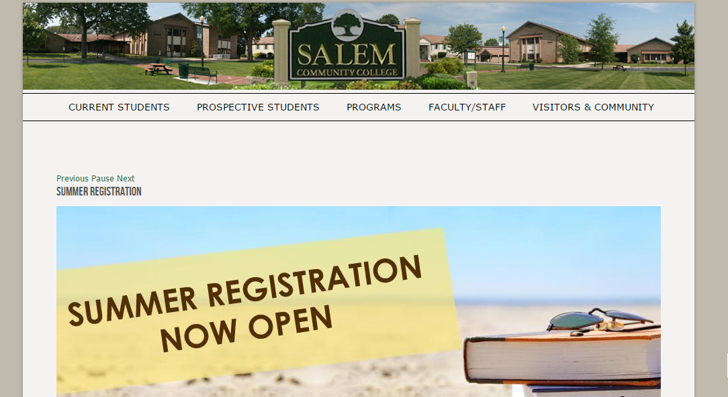
How to access the library databases at Salem Community College
Go to our website www.salemcc.edu and click on “Current Students” and then click “Library” from the dropdown list.
Click on “Databases and Journal Articles” on the left-hand menu.
  When you are on-campus, you will automatically have free access to these databases, but when you are off-campus, you will be prompted to enter your 10-digit SCC ID#.

Slide 8



Popular Databases
LexisNexis
ERIC
Newspaper Source Plus
*These databases are a good starting point for your research. Remember to preview (skim) articles and read selectively.
Only print out articles that you really need.

Slide 9
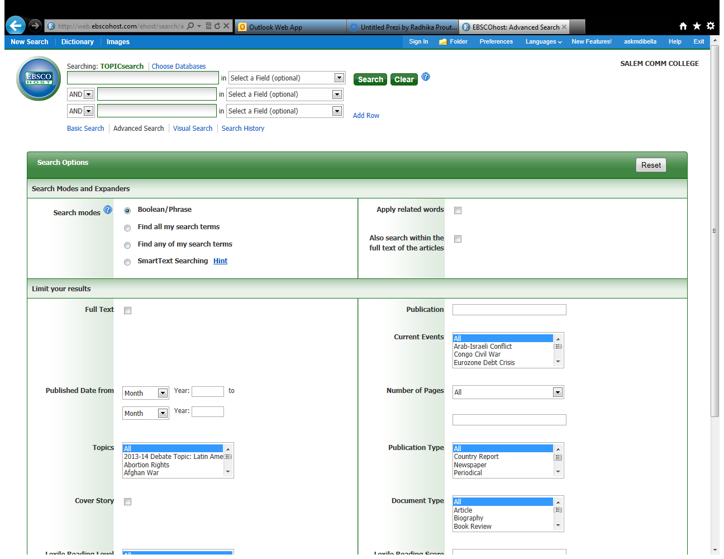
EBSCO Host Databases
Use Boolean search operators “AND” “OR” and “NOT” to find what you are looking for; also limit your search by date, publication location and type. The better your search terms, the better your results will be.

Slide 10
Government Websites
Government websites (end in .gov) can also be relied upon for credible source information.
The Government Printing Office maintains a searchable Catalog of U.S. Government Publications. www.gpoaccess.gov
A directory of all federal sites that provide statistical information: www.fedstats.gov

Slide 11
Evaluating your sources
To determine the usefulness of your sources, ask yourself the following questions:
Is the material recent enough? (some topics like the health care law debate require the most up-to-date materials)
Does the author have suitable credentials?
Is the author expressing a fact, an opinion or both?
Is the source reputable? (sources such as The New York Times, a major newspaper, would be considered reputable, whereas unrecognized sources like a personal blog would not be considered reputable)

Slide 12
Take notes on your sources
Write down title, author, publication information, and page numbers for all of your sources (you will need this information for your works cited page)
Consider creating notecards for each of your sources (see p. 270 of your S&S Handbook for an example).
Paraphrase information you may want to cite in your essay—that is, write notes in your own words.

Slide 13
Avoiding Plagiarism
Using someone else’s words or ideas without properly giving them credit is called plagiarism.
All sources must be cited!!! That is, you must mention the source of all information/ideas you learned in your research. Even if you don’t write those ideas word-for-word, you still must credit the source.
See Chapter 19 of your S&S Handbook for more information.

Slide 14
Quoting, Paraphrasing, and Summarizing Sources
Notes on Ch. 18 of the Simon & Schuster Handbook for writers

Slide 15
Quoting, Paraphrasing, & Summarizing
Quoting: using the exact words of a source, enclosed with quotation marks.
  Well-chosen brief quotes can add authority to your writing.
  See guidelines for using quotes on p. 205 of your S&S Handbook
  Make sure your quotations fit smoothly with your sentences (see pp. 204-209 of your S&S Handbook)

Slide 16
Create a “quotation sandwich”
The statement that introduces the quote is the top slice of bread.
The quote is filling the sandwich.
The interpretation/ explanation is the bottom slice of bread

Slide 17
Create a “quotation sandwich”
According to Smith and Jackson, “One of out five drivers has driven while drowsy” (205). This means that it is likely that we have been on the road at the same time as someone else who is too tired to drive and putting our lives in danger.

Slide 18
Quoting, Paraphrasing, & Summarizing
Paraphrasing: restating in your own words the written or spoken words of someone else.
  Paraphrasing is preferred over directly quoting sources because you want the majority of your essays to be in your own words and writing style.
  See guidelines for writing paraphrases on p. 210 of your S&S Handbook

Slide 19
Quoting, Paraphrasing, & Summarizing
Summarizing: a summary differs from a paraphrase in an important way: Whereas a paraphrase restates the original material in its entirety, a summary states only the main points of the original source in a much briefer form.
  See guidelines for summarizing on p. 213 of your S&S Handbook

Slide 20
Useful verbs for integrating quotes, paraphrases, and summaries:
Use a variety of present-tense verbs to introduce source material
“Flag” page 216 of your S&S Handbook for a helpful list of verbs.
Acknowledges
Concedes
Confirms
Argues
Introduces
Notices
Reports
Writes
Refutes

Slide 21
MLA Parenthetical Citation
Modern Language Association (MLA) citation is the standard for academic writing.
Any time you reference information or ideas that are not your own, you must provide proper parenthetical citation using the MLA citation rules.
If you fail to cite your sources or incorrectly cite your sources, your work will be considered plagiarized and you will be penalized.

Slide 22
Writing Parenthetical Text Citations
Introduce source material in the present tense
  Joan Smith agrees . . .
  Another researcher remarks . . .
  According to the American Academy of Pediatrics . . .
Paraphrase, directly quote, or summarize the source material and then include the author’s name and page number in parentheses at the end of the sentence, BEFORE the period.
  Joan Smith agrees that corporal punishment is not a legitimate form of discipline in schools (104).
  Another researcher remarks, “Corporal punishment teaches children to solve problems with violence” (Hayes 20).
  According to the American Academy of Pediatrics, all corporal punishment should be banned in schools (“Corporal Punishment in Schools”). *Note, this source did not have a named author or page number.

Slide 23
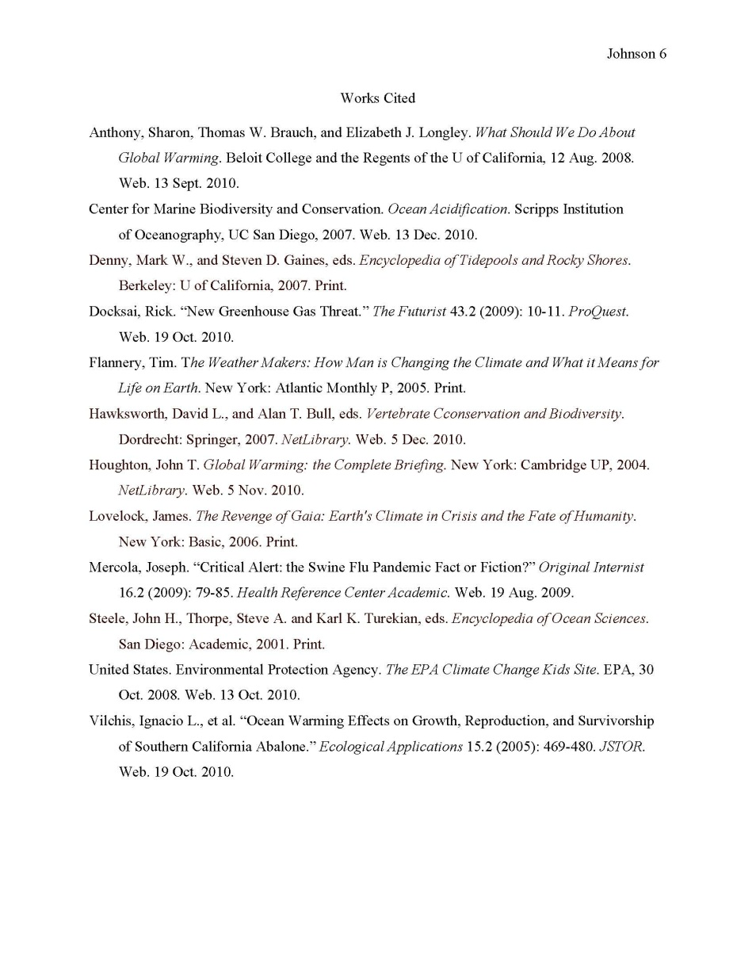
Writing the Works Cited Page
In addition to introducing your source material and providing parenthetical text citations, MLA documentation requires that you also provide a works cited page at the end of your essay.
The works cited page is a alphabetical listing all sources from which you paraphrased, summarized, and quoted (it is not a listing of all the sources you consulted during your research).
Consult Ch. 25 in your S&S Handbook for instructions on how to format your works cited page.

Slide 24

MLA Works-Cited Examples
Works-cited entry for a book (one author)
  Doctorow, Ethan. The March. New York: Random, 2005. Print.
Works-cited entry for a book (two authors)
  Merriam, Sharon, and Rosemary Caffarella. Learning in Adulthood. San
  Francisco: Jossey-Bass, 1999. Print.
Publication information.
Type of media (Print or Web source).
Author’s name.
Title of book.

Slide 25
MLA Works-Cited Examples
See Chapter 25 in your S&S Handbook for many more examples.
Works-cited entry for periodical (e.g. magazine or journal article)
  Author’s name. “Title of article.” Publication information.
  Example:
  Danielewicz, Jane. “Personal Genres, Public Voices.” College Composition and Communication 59.3 (2008): 420-50. Print.
Works-cited entry for web source
  Author’s name. “Title of work.” Title of overall website. Publisher or sponsor of the site, date of publication. Medium of publication (Web). Date of access.
  Example:
  Dickler, Jennifer. “Economy Makes People Sick.” Cable News Network, 7 June 2011. Web. 7 June 2011.
Works-cited entry for database source
  Author’s name. Print publication information. Name of database. Medium of publication (Web). Date of access.
  Example:
  Hede, Jasper. “Jews and Muslims in Dante’s Vision.” European Review 16.1 (2008): 101-14. Academic Search Premier. Web. 14 Sept. 2011.

Slide 26
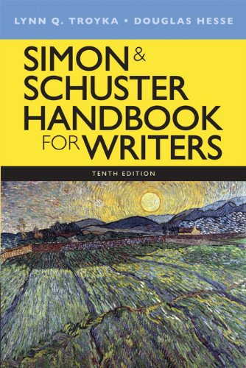
Resources in the
Simon & Schuster
Handbook for Writers
Part 3: Source-based writing
  Ch. 18: Quoting, paraphrasing and summarizing
  Ch. 19: Avoiding plagiarism
Part 4: Research and documentation
  Ch. 21: Starting and planning research projects
  Ch. 22: Finding published sources
  Ch. 25: MLA documentation
  MLA sample paper on pp. 350-360

Slide 27
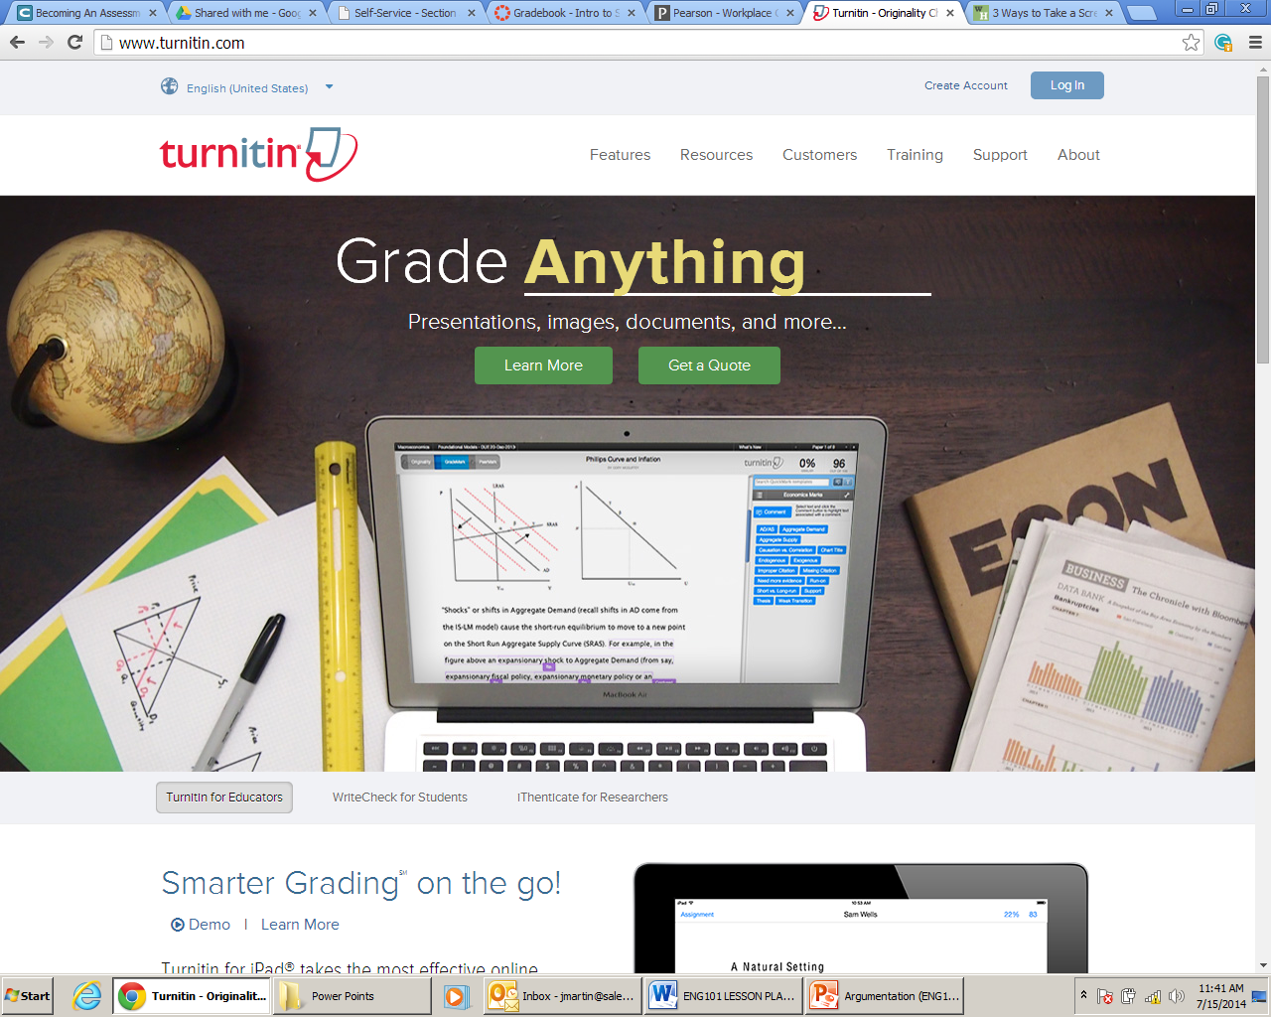
www.TurnItIn.com

