Slide 1
Lecture 7
Byzantine, Islamic, and Early Medieval Civilization

Slide 2
Lecture Objectives
To show that Byzantine and Islamic civilizations flourished while the West was recovering from the fall of Rome
To demonstrate the importance of religion to the varied worlds of Late Antiquity
To suggest that with Charlemagne, the idea of Europe was born

Slide 3
Introduction
Periodization
A distinctive western European culture began to emerge
A unique blending of three distinct traditions
the Greco-Roman tradition
the Judeo-Christian tradition
Germanic custom
Imperial power shifted to the Byzantine Empire
Constantinople

Slide 4
Justinian
Justinian (c. 482–565)
restore the empire of the East and West
revision and codification of Roman law
534 Corpus Juris Civilis (Body of Civil Law)
Justinian’s wife, Theodora (c. 500–547)
532 Nika Riots
killed 35,000 people in a single day
Public works projects
Hagia Sophia (Church of the Holy Wisdom)

Slide 5
Justinian
Religion and Justinian
the patriarch of Constantinople had crowned emperors in Constantinople
In 380, Christianity had been proclaimed the official religion of the eastern Empire
Arianism—the belief that Jesus was not of one substance with God
Monophysitism—Jesus has one nature
Iconoclasm—the attempt to abolish the use of icons and images in church services
Limited toleration of Jews

Slide 6
Justinian
1500 Cities as strength
Constantinople
The shift to the east
Legacy to the West
Bulwark against Islam
Preserved an independent and Christian West
Preservation of classical literature
Art and architecture

Slide 7
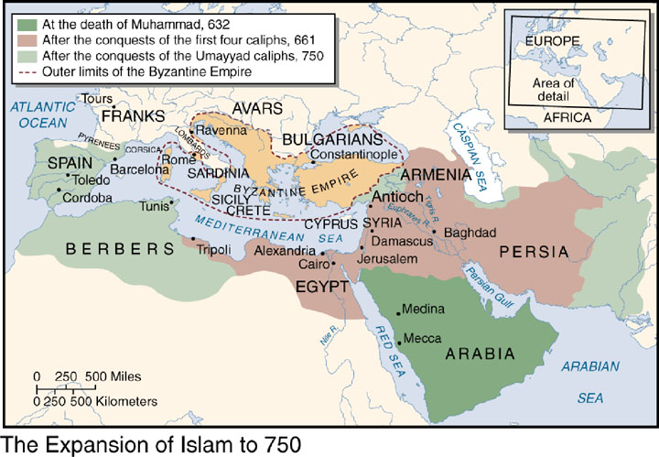
Map_07.01.jpg

Slide 8
Islam
Islam was both a threat and a source of new ideas to the Greek East and Latin West
Between the seventh and twelfth centuries, Islam became the center of a brilliant civilization and of a great scientific, philosophic, and artistic culture
Islam absorbed a great deal of Greek culture, which it managed to preserve for the Latin West

Slide 9
Islam
In the beginning, the Muslims were both open and cautious
They borrowed and integrated elements of other cultures into their own
Islam adopted elements of Christian, Jewish, and pagan religious beliefs and practices
The Muslims tolerated religious minorities within territories they had conquered, so long as these minorities recognized Islamic political rule, paid taxes, and did not proselytize among Muslims
Fundamental to Islam was its religion—this is true for the medieval West as well
The home of Islam is the Arabian Peninsula
Politically, Islam was not a unified territory nor was there any centralized government

Slide 10
Muhammad
Muhammad (c. 570–632)
Born in Mecca and orphaned at age 6
Mecca was one of the most prosperous caravan cities
The Kaaba
Muhammed’s early life
Married at 25 to a wealthy widow
He also became a kind of social activist, critical of Meccan materialism, paganism, and the unjust treatment of the poor and needy
He left Mecca for the isolation of the desert, and in 610 he received his first revelation and began to preach
He believed his revelations came directly from God, who spoke to him through the angel Gabriel
These revelations grew into the Qur’an, which his followers compiled between 650 and 651

Slide 11
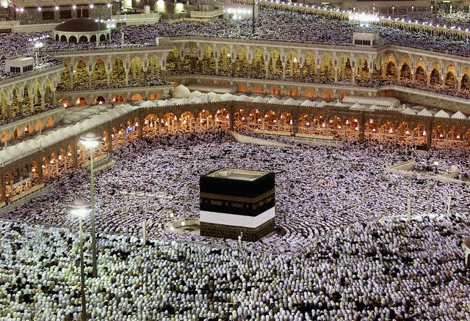
grand mosque_UT0067644.jpg
Notes:
NEARLY ONE MILLION PILGRIMS FACE GRAND MOSQUE DURING SUNSET PRAYERS IN MECCA © Reuters/CORBIS

Slide 12
Muhammad
Muhammad message to all Arabs was to submit to God’s will
Islam means “submission to the will of God”
There was little that was new in Muhammad’s message
The Qur’an recognized Jesus Christ as a prophet but does not view him as God’s equal and eternal son
Like Judaism, Islam was a monotheistic and theocratic religion, not a Trinitarian one like Christianity

Slide 13
Muhammad
The basic beliefs of Muhammad’s religion are
God is good and omnipotent
God will judge all men on the last day
Men should thank God for making the world as it is
God expects men to be generous with their wealth
Muhammad was a prophet sent by God to teach men and warn them of the last judgment

Slide 14
Muhammad
Muhammad’s religion grew as a result of the social and economic conditions of Mecca itself
For Muhammad, there were also five obligations, which were essential to his faith:
The profession of faith—there is no God but Allah and Muhammad was the last prophet
Prayers had to be uttered five times daily
The giving of alms, or charity
Fasting
The pilgrimage to Mecca

Slide 15
Muhammad
Muhammad met with disappointment as he preached his religion at Mecca
He left for the northern city of Medina in the year 622
The journey to Medina—the hegira (the breaking of former ties)—became the true foundation of the Islamic faith
After settling in Medina, his followers began to attack the caravans on their way to and from Mecca
By 624, his army was powerful enough to conquer Mecca
Muhammad died in 632
Muhammad never named a successor, and so after his death, some of his followers selected Abu Bakr, a wealthy merchant and Muhammad’s father-in-law, as caliph, or temporal leader

Slide 16
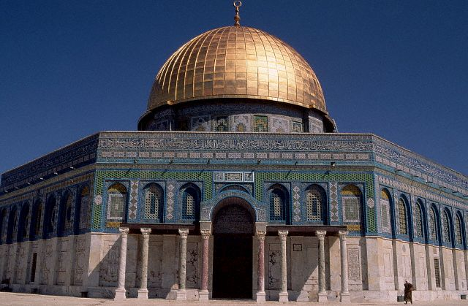
jerusalem dome_EG002250.jpg
Notes:
Dome of the Rock, Jerusalem © Carmen Redondo/CORBIS

Slide 17
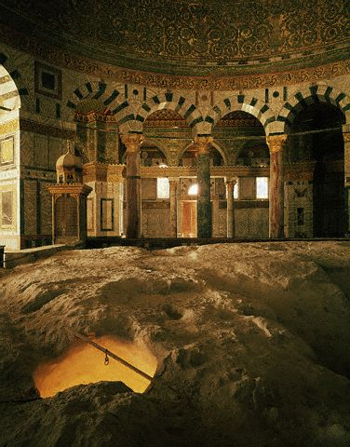
Mosque of Omar
Notes:
Interior of the Mosque of Omar © David Lees/CORBIS

Slide 18
Muhammad
In the early seventh century, Muhammad took up the Arab custom of making raids against their enemies
The Qur’an called these raids the jihad (striving in the way of the Lord)
Beginning in 636, the Muslims defeated the Byzantine army, Syria, the entire Persian empire, Egypt, North Africa, and Spain
The Battle of Tours (732)
Ends expansion of Islam west
8-9th centuries was a golden age as Arabic, Byzantine, Persian, and Indian cultural traditions were integrated
Saved western civilization

Slide 19
Islam Recap
Muhammed
The impact of early Islamic civilization on Europe
Economics
Trade, carravans
Baghdad: glassware, jewelry, pottery, silks
Morocco and Spain: leather- working
Toledo: swords
Paper
Technology
New vocabulary: traffic, alcohol, muslin, orange, lemon, sugar, musk
Greek philosophical and scientific knowledge
Astrology as applied science
Astronomy
Cancer and medicines, hospitals
Optics, alchemy
Preservation and interpretation of the works of Aristotle

Slide 20
Map_07.01.jpg

Slide 21
Islamic Tile

Slide 22
The Early Middle Ages in Europe
The Dark Ages
People became more closely attached to the land because their survival depended upon it
Scholars
They were trying to create a Christian culture that combined the Greco-Roman tradition with a faith in Christianity and support of the church

Slide 23
Boethius
Boethius (c. 475–524)
A Roman statesman and philosopher descended from a prominent senatorial family
He studied philosophy, mathematics, and poetry at Plato’s Academy
In 510, Boethius was appointed consul and “Master of Offices.”
In 522 he was arrested, condemned, and sent into exile to await execution
Boethius wrote a short book called The Consolation of Philosophy
Classical humanism
Boethius exerted a major influence in Western intellectual life
Virtually all of what Europe knew about Aristotle came from Boethius
Euclidean geometry
In 524, Theodoric confirmed his sentence and Boethius was bludgeoned to death
Cassiodoris (c. 485–c. 580), Gregory of Tours (538–c. 5 94), and Isidore of Seville (c. 560–636) all helped to keep classical scholarship alive

Slide 24
The Kingdom of the Franks
Individual kingdoms
Church was controlled by members of the educated elite who provided the bureaucrats and administrative officials
Frankish king Clovis (465–511)
Expansion
Conversion to Christianity
Holy wars
Civil Wars

Slide 25
Charlemagne
Charlemagne (742–814)
Europe born
Stability based on three elements: the Roman past, the Germanic way of life, and Christianity
Frankish society was entirely rural and was composed of three classes or orders
the peasants—those who work
poverty and hardship
illiterate
the nobility—those who fight
Slightly better
illiterate and crude
fighting
the clergy—those who pray
most educated

Slide 26
Charlemagne
When Charlemagne took the throne in 771, he immediately implemented two policies
Expansion
religious

Slide 27
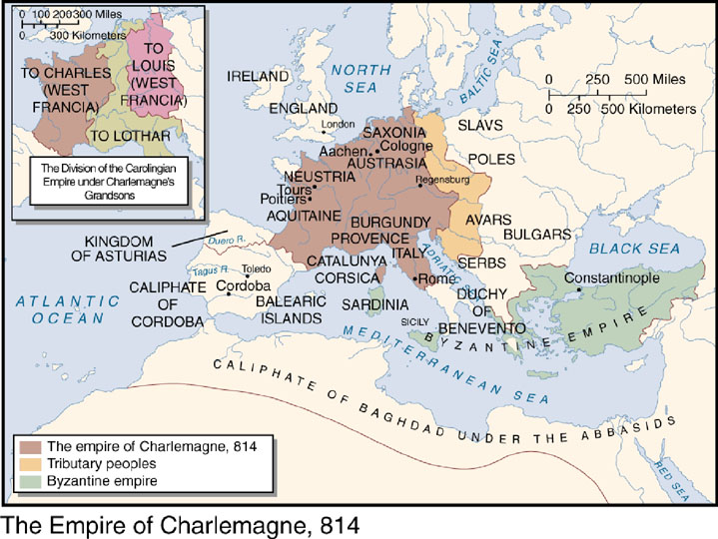
Map_07.02.jpg

Slide 28
Charlemagne and Pope Leo III
Charlemagne crowned on Christmas Day, 800
Who crowns kings?
Charlemagne's rule
He divided his kingdom into several hundred counties or administrative units
There was no fixed capital
Standardized the minting of coins
Expanded trade

Slide 29
The Revival of Learning
Charlemagne’s and Education
Errors in translation
Charlemagne could not find one good copy of the Bible, nor a complete text of the Benedictine Rule
Charlemagne was devoted to new ideas and to learning
He studied Latin, Greek, rhetoric, logic, and astronomy
Alcuin of York (c. 735–804)
the seven liberal arts
the trivium: grammar (how to write), rhetoric (how to speak), and logic (how to think)
the quadrivium: geometry, arithmetic, astronomy, and music

Slide 30
The Revival of Learning
Scriptoria
Correct copies
Carolingian minuscule
Standardized medieval Latin
A Christian republic

Slide 31
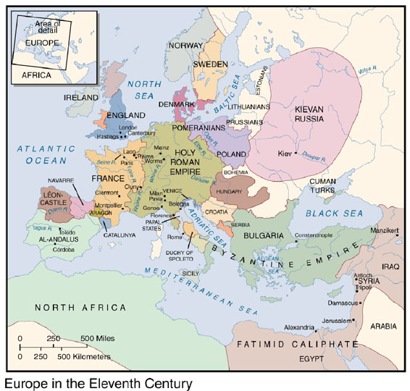
Map_07.03.jpg

Slide 32
Conclusion
The decline of Charlemagne’s empire
Viking and Muslims
Internal strife

