Slide 1
Lecture 8
Medieval Technology and Social Change

Slide 2
Lecture Objectives
To illustrate how the agricultural revolution of the early Middle Ages set in motion profound social, economic, and political changes
To compare the technology of ancient Near Eastern hydraulic civilizations with medieval Europe
To show how medieval technology opened the door to the early modern European global expansion

Slide 3
Europe in 1000
The aftermath of the Fall of Rome
Chaos and disorder
Survival
Fragmented and weak.
Comparisons to hydraulic societies
Water and food management
What a difference a few centuries could make
By 1500, Europe will be a dominate world power

Slide 4
The Agricultural Revolution II
Pop. of Europe increased 38% from 600-1000. Why?
Natural Resources
Land
Crops and cattle
Amount declines do to pop. Growth and increased size of cities
Forest depletion (ecological crisis) spurs innovation
How could a farmer etch out a living?

Slide 5
Scratch Plow

Slide 6
Medieval Microchips
The heavy plow
Furrows created
The Horse and Collar
Faster and could go farther from home
Horseshoe

Slide 7
Medieval Microchips, cont.
Three-Field crop rotation
Planting rotated over a three years cycle
These new technologies produced a variety of social consequences:
The deep plow made it possible to farm new lands, accounting for the northward shift of European agriculture in the Middle Ages.
Because the heavy plow and its team of horses were expensive tools, and beyond the capacities of individual peasant farmers to own them, they brought collective ownership and patterns of communal agriculture.
The solidification of the medieval village and the manorial system as the foundation of European society.

Slide 8
Medieval Microchips, cont.
Three-Field crop rotation’s advantages
Springtime oats and Veggies
Agriculture increased 50%, prices dropped, starvation declined
Pop. In 1300 was at 79 million
Paris went from 28,000 in 600 to 228,000 in 1300

Slide 9
Medieval Microchips, cont.
Military technology
The armored knight
The stirrup
This new technology matched easily with the manorial system brought about by the revolution in agriculture
Knight replaced the peasant-soldier and a fulltime employee
A feudal relationship
No strong central govt. needed
The manorial system was well-adapted to the European ecology, and the knight-village relation became characteristic of European feudalism and the manorial system
The village supported the knights and the knight protected the village
Too many knights, look to expand

Slide 10
The Feudal System

Slide 11
Medieval Machines
Water-powered machines
The waterwheel
The need for water-driven mills may be attributed to a general lack of surplus labor and to the increased production generated by the Agricultural Revolution
Serfdom withers away

Slide 12
Technology and Science
If the twelfth century represents a period of translation, the thirteenth century represents a period of assimilation when European scholars began to absorb the scientific and philosophical traditions of antiquity
Aristotle and Scholasticism
Faith and reason were harmonized
The great condemnation of 1277
Frees science
A new tradition of observational and mathematical astronomy arose in western Europe

Slide 13
Famine, Plague, and War
A series of disruptions created havoc in Europe in the 14th century
Climate change
Famine
Black Death
Kills 35% of pop.
Avignon Papacy
100 Years ‘War
Peasant Revolts

Slide 14
The Gunpowder Revolution
The technology of gunpowder passed into Europe from the Islamic world after the Crusades
European engineers perfect guns, cannons and explosives
The gunpowder revolution undermined the military roles of the feudal knight and the feudal lord and replaced them with expensive gunpowder armies and navies financed by central governments
Battlefield changes
Musketeers
Need for larger armies
By 1700, the French standing army stood at 400,000 soldiers

Slide 15
Toward the Future
The military revolution shifted power from local authorities to centralized kingdoms and nation-states
favored technological development
wave of European colonialism

Slide 16
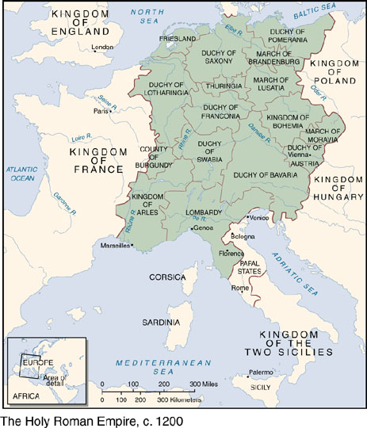
Map_08.05.jpg

Slide 17
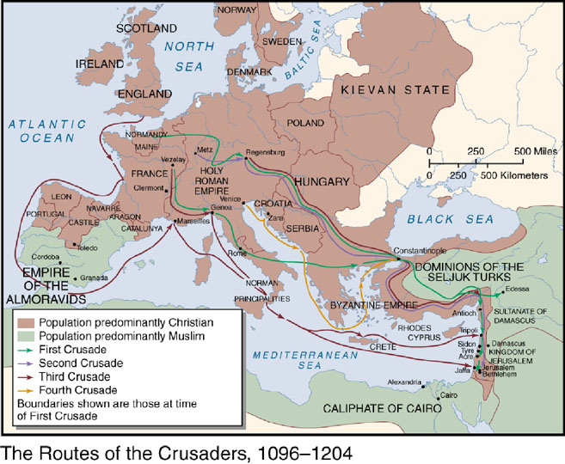
Map_08.03.jpg

Slide 18
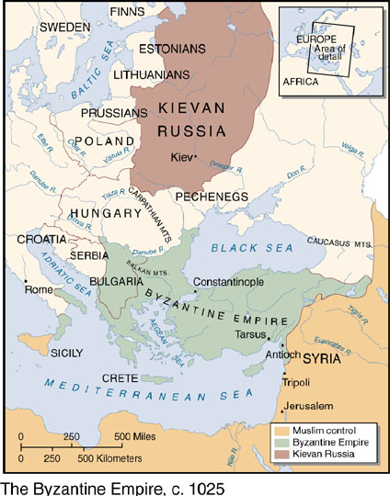
Map_08.02.jpg

