Slide 1
Chapter 6
Sensation and Perception

Slide 2
Chapter Overview
Basic Concepts of Sensation and Perception
Vision: Sensory and Perceptual Processing
The Nonvisual Senses

Slide 3
Basic Concepts of Sensation and Perception Processing Sensation and Perception
6-1: WHAT ARE SENSATION AND PERCEPTION? WHAT DO WE MEAN BY BOTTOM-UP PROCESSING AND TOP-DOWN PROCESSING?
Sensation and perception are actually parts of one continuous process.
Sensation: The process by which our sensory receptors and nervous system receive and represent stimulus energies from our environment
Perception: The process of organizing and interpreting sensory information, enabling us to recognize meaningful objects and events

Slide 4
Basic Concepts of Sensation and Perception Processing Sensation and Perception
Bottom-up processing is sensory analysis that begins at the entry level, with information flowing from the sensory receptors to the brain.
Top-down processing is information processing guided by high-level mental processes, as when we construct perceptions by filtering information through our experience and expectations.

Slide 5
Basic Concepts of Sensation and Perception Transduction
6-2: WHAT THREE STEPS ARE BASIC TO ALL OUR SENSORY SYSTEMS?
All our senses:
Receive sensory stimulation, often using specialized receptor cells
Transform that stimulation into neural impulses
Deliver the neural information to our brain
Transduction
Conversion of one form of energy into another. In sensation, it is the transforming of stimulus energies, such as sights, sounds, and smells, into neural impulses our brain can interpret.

Slide 6
Basic Concepts of Sensation and Perception Thresholds
6-3: HOW DO ABSOLUTE THRESHOLDS AND DIFFERENCE THRESHOLDS DIFFER, AND WHAT EFFECT, IF ANY, DO STIMULI BELOW THE ABSOLUTE THRESHOLD HAVE ON US?
Absolute thresholds
The minimum stimulus energy needed to detect a particular stimulus 50 percent of the time
Tested by defining the point where half the time a stimulus is detected and half the time it is not
That 50-50 point defines the absolute threshold.
Gustav Fechner (1801–1887), a German scientist and philosopher, studied our awareness of these faint stimuli

Slide 7
Basic Concepts of Sensation and Perception Thresholds
Signal detection theory
Predicts how and when we will detect a faint stimulus (signal) amid background stimulation (noise)
Individual thresholds vary depending on the strength of the signal and also on our experience, expectations, motivation, and alertness

Slide 8
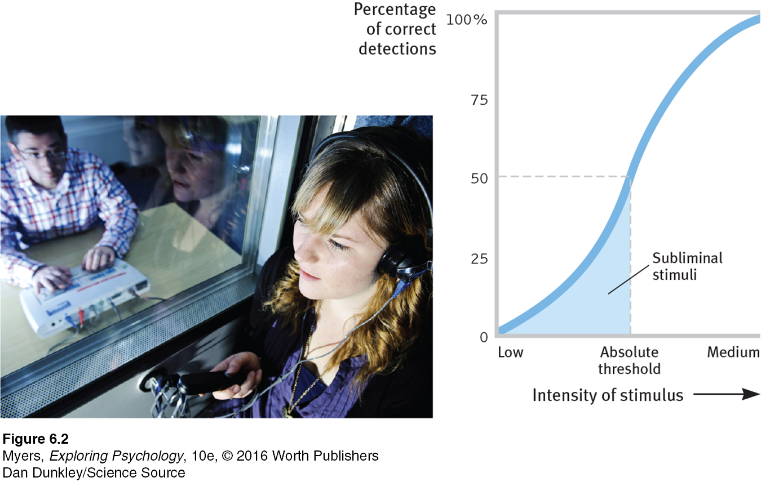
Absolute threshold
Subliminal
Input below the absolute threshold for conscious awareness
Priming
Activating, often unconsciously, associations in our mind, thus setting us up to perceive, remember, or respond to objects or events in certain ways
Absolute threshold
Minimum stimulation needed to detect a particular stimulus 50% of the time
Can see a far away light in the dark, feel the slightest touch
Notes:
Figure 16.2
Human have strengths and weaknesses in ability to detect and interpret stimuli.
We are ignorant of many stimuli
X-rays, radio waves, ultraviolet and infrared light
Very high and very low frequency sounds
Other organisms use stimuli we cannot detect
Birds use magnetic compass
Bats and dolphins use sonar
Bees and ants see polarization of sunlight for navigation

Slide 9
Basic Concepts of Sensation and Perception Thresholds
Difference threshold
Minimum difference a person can detect between any two stimuli half the time; increases with stimulus size
A 5 decibel increase in the volume will be noticed at a starting point of 40 decibels, but not at 110 decibels.
Difference threshold is experienced as a just noticeable difference (or jnd)
Weber’s law
For an average person to perceive a difference, two stimuli must differ by a constant minimum percentage (not a constant amount); the exact proportion varies, depending on the stimulus.

Slide 10
Subliminal Persuasion
6-4: DOES SUBLIMINAL SENSATION ENABLE SUBLIMINAL PERSUATION?
Subliminal stimuli are those that are too weak to detect 50 percent of the time; below the absolute threshold.
Subliminal sensation exists, but such sensations are too fleeting to enable exploitation with subliminal messages.
Subliminal persuasion may produce a fleeting and subtle but not powerful or enduring effect on behavior (Greenwald, 1992).
Experiments disprove claims of the effectiveness of subliminal advertising and self-improvement.

Slide 11
Basic Concepts of Sensation and Perception Sensory Adaptation
6-5: WHAT IS THE FUNCTION OF SENSORY ADAPTATION?
Sensory adaptation
Is diminished sensitivity as a consequence of constant stimulation
Aids focus by reducing background chatter
Influences how the world is perceived in a personally useful way
Our sensory receptors are sensitive to novelty; sensory adaptation even influences how we perceive emotions
We perceive the world not exactly as it is, but as it is useful for us to perceive it.

Slide 12
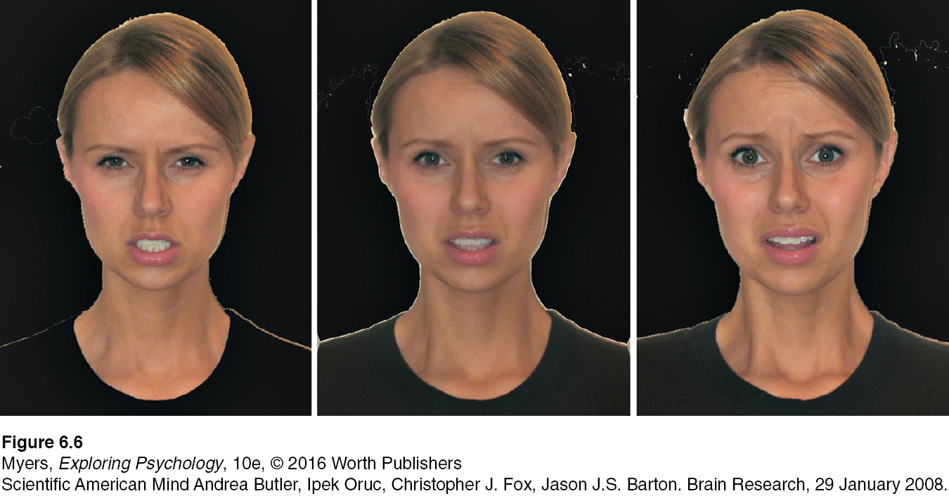
Emotion adaptation
Gaze at the angry face on the left for 20 to 30 seconds, then look at the center face (looks scared, yes?). Then gaze at the scared face on the right for 20 to 30 seconds, before returning to the center face (now looks angry, yes?). (From Butler et al., 2008.)
Notes:
Figure 16.6

Slide 13
Perceptual Set
6-6: HOW DO OUR EXPECTATIONS, CONTEXTS, MOTIVATION, AND EMOTIONS INFLUENCE OUR PERCEPTIONS?
Perceptual set
Mental tendencies and assumptions that affect (top-down) what we hear, taste, feel, and see
What determines our perceptual set?
Schemas organize and interpret unfamiliar information through experience
Preexisting schemas influence top-down processing of ambiguous sensation interpretation, including gender stereotypes
Notes:
Perceptions are influenced, top-down, not only by our expectations and by the context, but also by our emotions and motivation.

Slide 14
Context Effects
CULTURE AND CONTEXT EFFECTS
What is above the woman’s head? In one classic study, nearly all the East Africans who were questioned said the woman was balancing a metal box or can on her head and that the family was sitting under a tree.
What do you think Westerners said?
Context effects
A given stimulus may trigger different perceptions because of the immediate context.
Notes:
Figure 16.9 Culture and context effects
A given stimulus may trigger different perceptions, partly because of differing perceptual set, but also because of the immediate context.
Westerners, for whom corners and boxlike architecture were more common, were more likely to perceive the family as being indoors, with the woman sitting under a window. (Gregory & Gombrich, 1973.)

Slide 15
Motivation and Emotion
Motivation and Emotion
Perceptions are also influenced by our motivation and emotions.
Walking destinations look farther away when fatigued
Slopes look steeper when wearing a heavy backpack (or after listening to sad, heavy classical music)
Water bottles look closer when thirsty
Emotions and motives also influence our social perceptions

Slide 16
Vision: Sensory and Perceptual Processing Light Energy and Eye Structures
Wavelength—Distance from the peak of one light wave or sound wave to the peak of the next. Electromagnetic wavelengths vary from the short blips of cosmic rays to the long pulses of radio transmission.
6-7: WHAT ARE THE CHARACTERISTICS OF THE ENERGY THAT WE SEE AS VISIBLE LIGHT? WHAT STRUCTURES IN THE EYE HELP FOCUS THAT ENERGY?
The Stimulus Input: Light Energy
Intensity—Amount of energy in a light wave or sound wave, which influences what we perceive as brightness or loudness. Intensity is determined by the wave’s amplitude (height).
Hue—Dimension of color that is determined by the wavelength of light; what we know as the color names blue, green, and so forth.

Slide 17
Light Energy and Eye Structures The Stimulus: Light Energy
What is seen as light is only a thin slice of the broad spectrum of electromagnetic energy.
The portion visible to humans extends from the shorter waves of blue-violet light to the longer waves of red light.
Other organisms are sensitive to differing portions of the spectrum; bees, for instance, cannot see what we perceive as red but can see ultraviolet light.
The perceived hue in a light depends on its wavelength, and its brightness depends on its intensity.
Notes:
See Figure 17.1

Slide 18
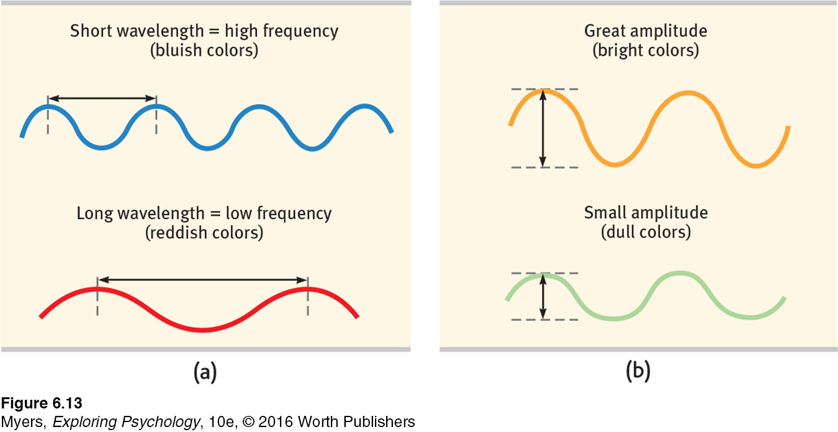
The Physical Properties of Waves
Waves vary in wavelength, the distance between successive peaks. Frequency, the number of complete wavelengths that can pass a point in a given time, depends on the length of the wave. Wavelength determines the perceived color of light.
Waves also vary in amplitude, the height from peak to trough (top to bottom). This wave amplitude influences the brightness of colors (and also the loudness of sounds).
Notes:
Figure 17.2
The shorter the wavelength, the higher the frequency. Wavelength determines the perceived color of light (and also the pitch of sound).
Physical energy seen as light
Wavelength: Distance from one wave peak to the next
Hue: Color experienced
Amplitude: Height
Intensity: Amount of contained energy; influences brightness

Slide 19
Light Energy and Eye Structures
The Eye
Cornea: portion of the eye through which light passes (to the pupil and lens) and is bent to help provide focus
Pupil: a small adjustable opening through which the light then passes
Iris: a colored muscle surrounding the pupil that controls its size
Lens: focuses incoming light rays onto an image on the retina on the eyeball’s sensitive inner surface
After entering the eye and being focused by a lens, light energy particles strike the eye’s inner surface, the retina.

Slide 20
Light Energy and Eye Structures
The Retina
Retina contains receptors rods and cones.
Retina has layers of neurons that begin the processing of visual information.
Accommodation
The process by which the eye’s lens changes shape to focus near or far objects on the retina.

Slide 21
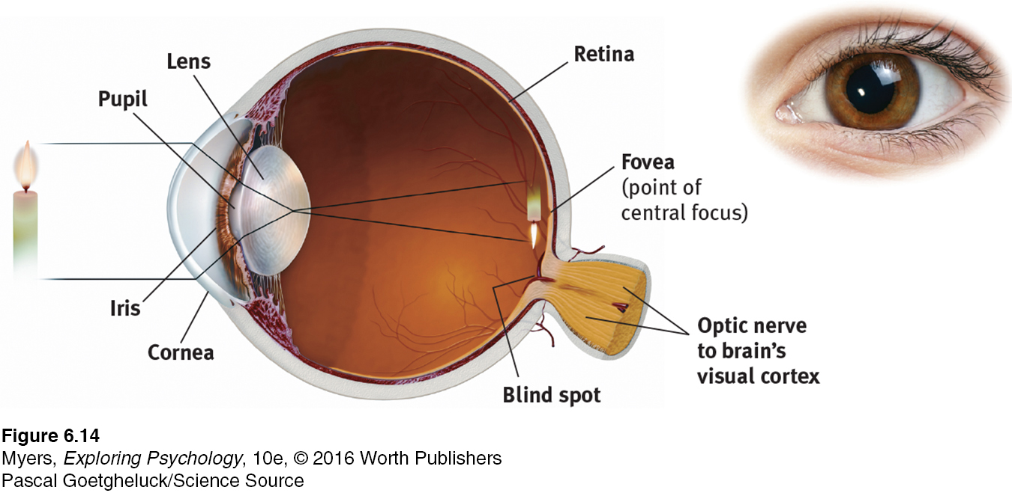
Vision: The Eye
Notes:
Figure 17.3
Light rays reflected from a candle pass through the cornea, pupil, and lens.
The curve and thickness of the lens change to bring nearby or distant objects into focus on the retina.
Rays from the top of the candle strike the bottom of the retina. Those from the left side of the candle strike the right side of the retina.
The candle's image appears on the retina upside down and reversed.

Slide 22
Information Processing in the Eye and Brain Retinal Processing
6-8: HOW DO THE RODS AND CONES PROCESS INFORMATION, AND WHAT IS THE PATH INFORMATION TRAVELS FROM THE EYE TO THE BRAIN?
Light-energy particles trigger chemical reactions in receptor cells, rods and cones, an outer layer of cells of the retina at the back of the eye
Rods: retinal receptors that detect black, white, and gray; sensitive to movement; necessary for peripheral and twilight vision (when cones don’t respond)
Cones: concentrated near the center of the retina; function in daylight or well-lit conditions; detect fine detail and color

Slide 23
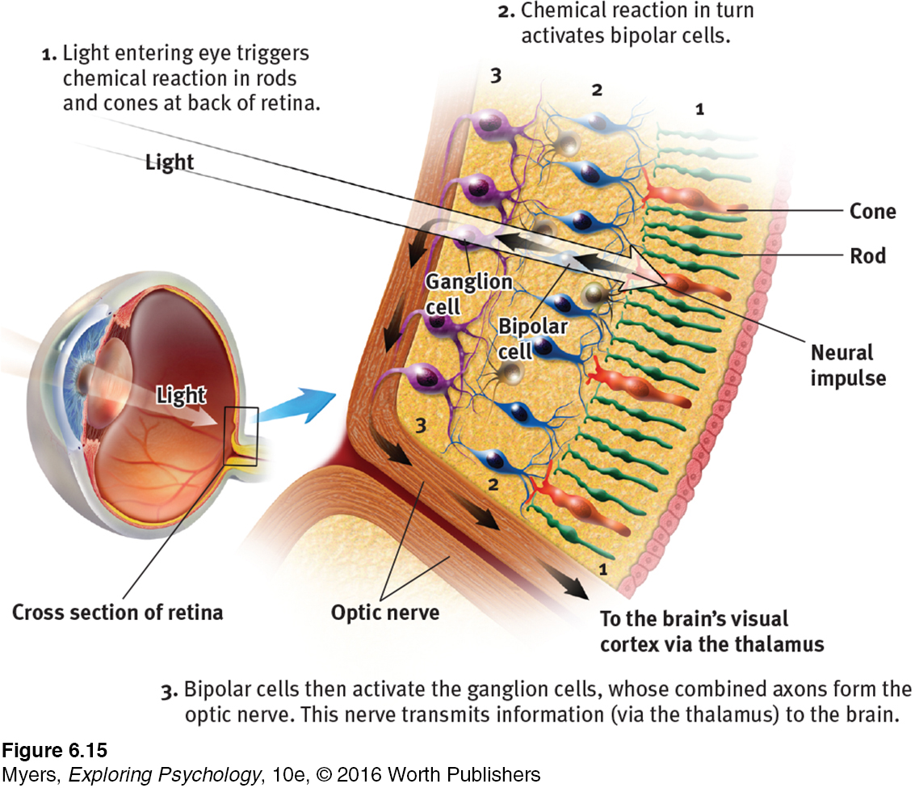
The Retina’s Reaction to Light
Notes:
Figure 17.4

Slide 24
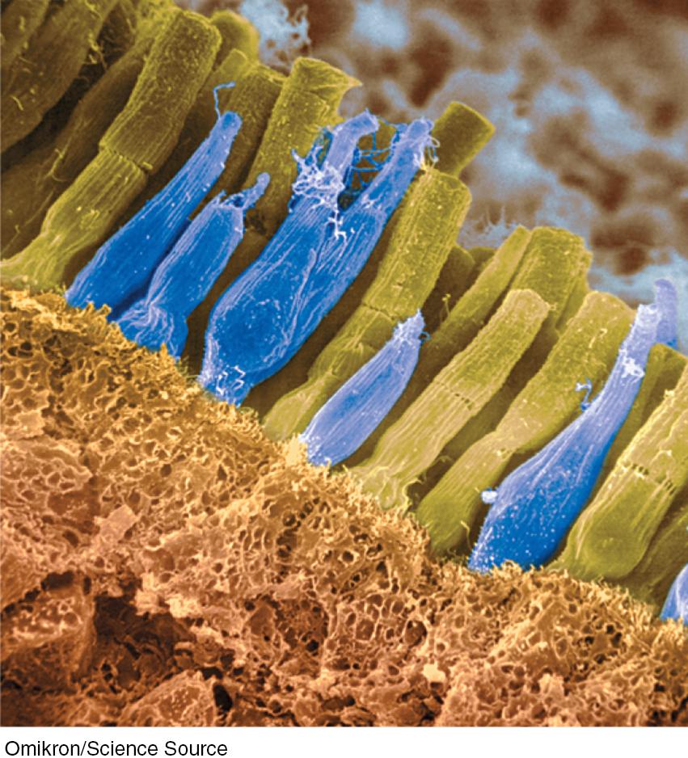
RODS AND CONES
Cones and rods each provide a special sensitivity
Cones are sensitive to detail and color
Rods are sensitive to faint light
Notes:
See Table 17.1
Rods detect black, white, and gray, and are necessary for peripheral and twilight vision.
Cones are clustered near the center of the retina; they detect fine detail and allow color vision.
Light energy triggers chemical changes in the rods and cones, which activate the bipolar cells.
These cells then activate the ganglion cells of the optic nerve, which transmits the neural impulses from the eye to the brain.

Slide 25
Information Processing in the Eye and Brain
Retinal Processing
Light-energy particles trigger chemical reactions in receptor cells, rods and cones, and outer layer of cells of the retina at the back of the eye
Chemical reaction in turn activates bipolar cells
Bipolar cells then activate the ganglion cells, whose combined axons form the optic nerve, which transmits the neural impulses from the eye to the brain

Slide 26
Information Processing in the Eye and Brain
Retinal Processing
Optic nerve: carries neural impulses from the eye to the brain
Blind spot: the point at which the optic nerve leaves the eye, creating a “blind” spot because no receptor cells are located here
Fovea: the central focal point in the retina, around which the eye’s cones cluster

Slide 27
Vision: Visual Information Processing: Pathway from the eyes to the visual cortex
Ganglion axons forming the optic nerve run to the thalamus, where they synapse with neurons that run to the visual cortex.
Notes:
Figure 17.6

Slide 28
Information Processing in the Eye and Brain Color Processing
6-9: HOW DO WE PERCEIVE COLOR IN THE WORLD AROUND US?
Color processing is a two-stage process:
Retina’s red, green, and blue cones respond in varying degrees to different color stimuli, as the Young-Helmholtz trichromatic theory suggested.
Cones’ responses are then processed by opponent-process cells, as Hering’s opponent-process theory proposed.

Slide 29
Information Processing in the Eye and Brain Feature Detection
6-10: WHERE ARE FEATURE DETECTORS LOCATED, AND WHAT DO THEY DO?
Feature detectors: specialized nerve cells in the brain that respond to specific features of the stimulus, such as shape, angle, or movement
These cells receive information from the ganglion cells in the retina, and then pass it to other cortical areas, where teams of cells (supercell clusters) respond to more complex patterns

Slide 30
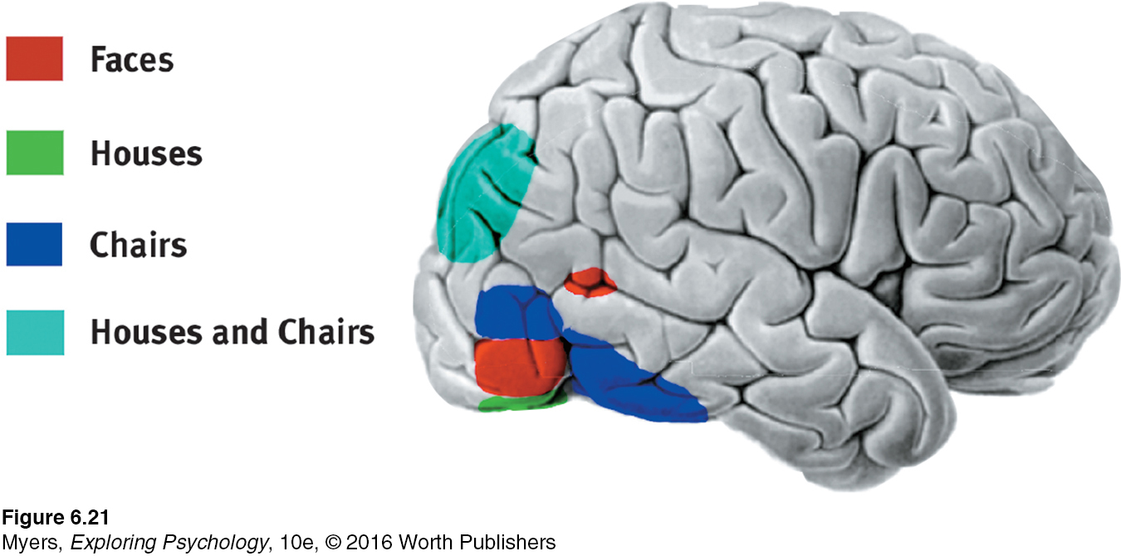
Information Processing in the Eye and Brain Feature Detectors
Hubel and Wiesel
Showed brain’s computing system deconstructs and then reassembles visual images
Found specialized occipital lobe neuron cells (feature detectors) receive information from ganglion cells and pass it to supercell clusters
THE TELLTALE BRAIN Looking at faces, houses, and chairs activates different brain areas in this right-facing brain.
Notes:
Figure 17.10

Slide 31
Information Processing in the Eye and Brain Parallel Processing
6-11: HOW DOES THE BRAIN USE PARALLEL PROCESSING TO CONSTRUCT VISUAL PERCEPTIONS?
Parallel processing: The brain's ability to do many things at once
A visual scene is first divided into subdimensions
Perceptions are constructed by integrating separate but parallel subdimensions

Slide 32
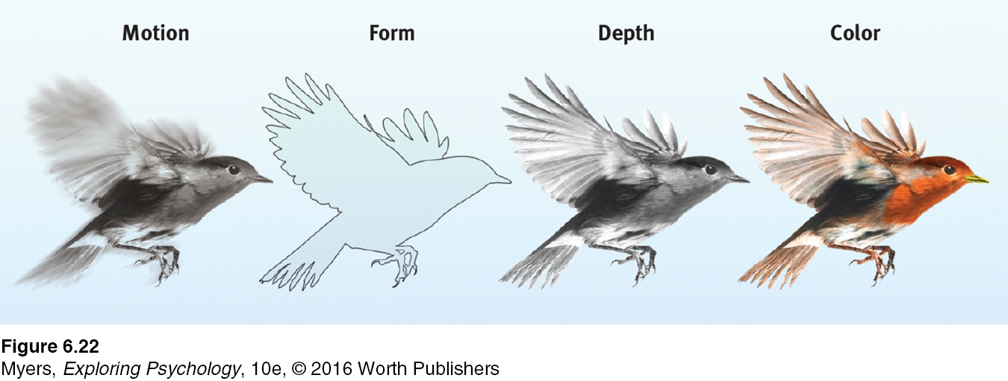
PARALLEL PROCESSING
Studies of patients with brain damage suggest that the brain delegates the work of processing motion, form, depth, and color to different areas. After taking a scene apart, the brain integrates these subdimensions into the perceived image.
Notes:
Figure 17.11 Brain divides the work of processing into subdimensions—motion, form, depth, color—and works on each aspect simultaneously (Livingstone & Hubel, 1988).
How does the brain do this? The answer to this question is the Holy Grail of vision research.

Slide 33
Perceptual Organization
6-12: HOW DID THE GESTALT PSYCHOLOGISTS UNDERSTAND PERCEPTUAL ORGANIZATION, AND HOW DO FIGURE-GROUND AND GROUPING PRINCIPLES CONTRIBUTE TO OUR PERCEPTIONS?
Gestalt: an organized whole
Gestalt psychologists propose principles used to organize sensations into meaningful wholes
In perception, the whole may exceed the sum of its parts
We filter incoming information and construct perceptions

Slide 34
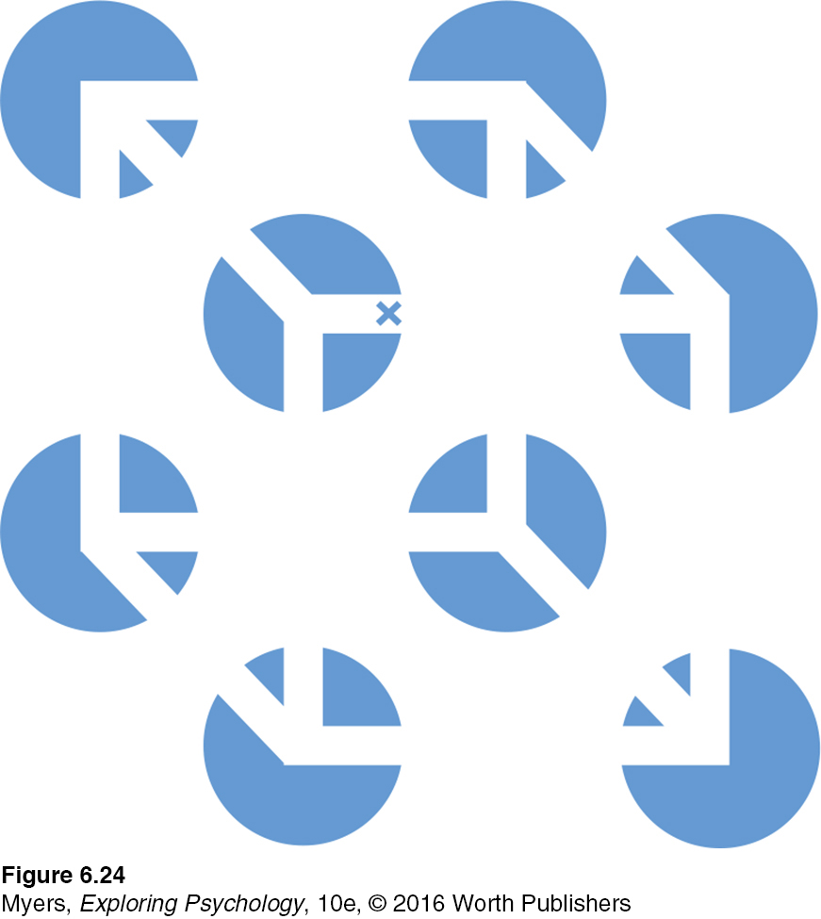
Vision: Visual Organization
How do we organize and interpret the shapes and colors into meaningful perceptions?
People tend to organize pieces of information into an organized whole, or Gestalt
Necker cube
Notes:
Figure 17.13 A Necker cube
What do you see: circles with white lines, or a cube?
If you stare at the cube, you may notice that it reverses location, moving the tiny X in the center from the front edge to the back.
At times the cube may seem to float forward, with circles behind it.
At other times, the circles may become holes through which the cube appears, as though it were floating behind them.
There is far more to perception than meets the eye. (From Bradley et al., 1976.)

Slide 35
Perceptual Organization: Form Perception
Figure-ground
The organization of the visual field into objects (the figures) that stand out from their surroundings (the ground)
Notes:
Figure 17.14

Slide 36
Perceptual Organization: Form Perception
Grouping
The perceptual tendency to organize stimuli into coherent groups:
Proximity: grouping nearby figures together
Continuity: perceiving smooth, continuous patterns, rather than discontinuous ones
Closure: Filling in gaps to create a complete, whole object

Slide 37
Grouping
Human minds use these grouping strategies to see patterns and objects.
Notes:
Proximity: We group nearby figures together. We see not six separate lines, but three sets of two lines.
Continuity: We perceive smooth, continuous patterns rather than discontinuous ones. This pattern could be a series of alternating semicircles, but we perceive it as two continuous lines—one wavy, one straight.
Closure: We fill in gaps to create a complete, whole object. Thus, we assume that the circles on the left are complete but partially blocked by the (illusory) triangle. Adding nothing more than little line segments to close off the circles and your brain stops constructing a triangle.

Slide 38
Perceptual Organization: Depth Perception
6-13: HOW DO WE USE BINOCULAR AND MONOCULAR CUES TO PERCEIVE THE WORLD IN THREE DIMENSIONS?
Depth perception
Represents ability to see objects in three dimensions, although the images that strike the retina are two dimensional
Allows us to judge distance
Is present, at least in part, at birth in humans and other animals

Slide 39
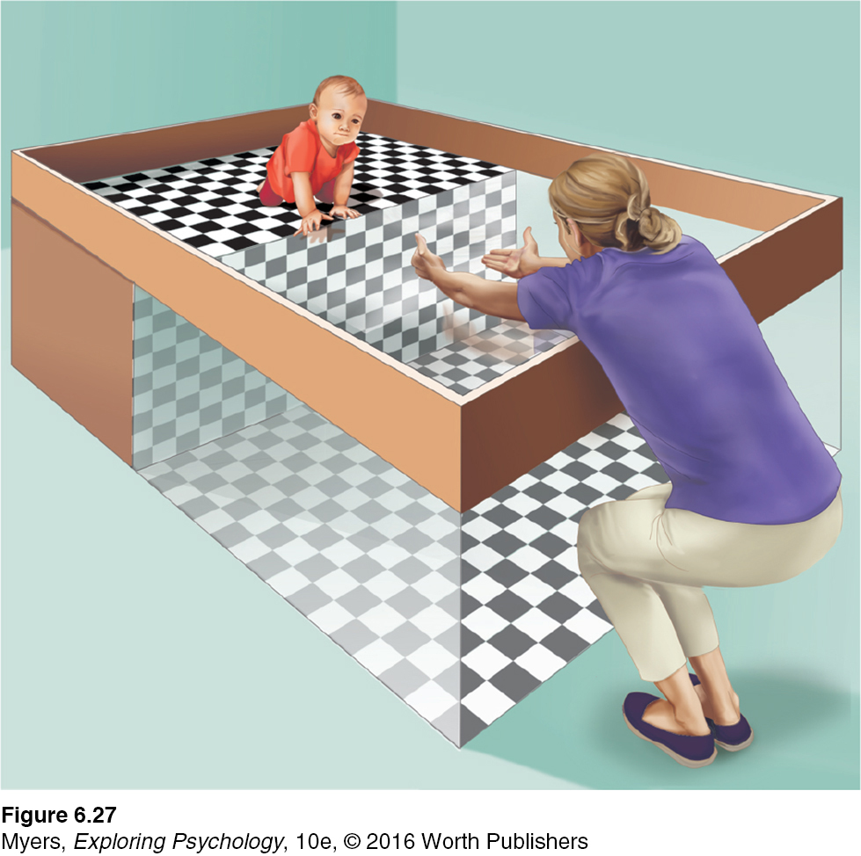
THE VISUAL CLIFF Eleanor Gibson and Richard Walk (1960)
Test of early 3-D perception
Most infants refuse to crawl across the visual cliff
Crawling, no matter when it begins, seems to increase an infant's fear of heights
Notes:
Figure 17.16
Depth cue: Pattern on floor
Visual cliff: Eleanor Gibson and Richard Walk devised this miniature cliff with a glass-covered drop-off to determine whether crawling infants and newborn animals can perceive depth. Even when coaxed, infants are reluctant to venture onto the glass over the cliff.

Slide 40
Perceptual Organization: Depth Perception
Binocular cues
Two eyes help perception of depth
Retinal disparity
Binocular cue for perceiving depth
By comparing images from the retinas in the two eyes, the brain calculates distance
Used by 3-D film makers
Notes:
Retinal disparity
Binocular cue for perceiving depth.
By comparing images from the two eyes, the brain computes distance—the greater the disparity (difference) between the two images, the closer the object.
Retinal disparity can differentiate between 1 and 10 feet away, but not between 10 and 100 feet

Slide 41
Perceptual Organization: Depth Perception
Monocular cues
Depth cue, such as interposition or linear perspective, available to either eye alone
Relative height
Relative size
Interposition
Linear perspective
Light and shadow
Relative motion

Slide 42
Perceptual Organization: Perceptual Constancy
6-14: HOW DO PERCEPTUAL CONSTANCIES HELP US CONSTRUCT MEANINGFUL PERCEPTIONS?
Perceptual constancy: Objects are perceived as unchanging (having consistent color, brightness, shape, and size), even as illumination and retinal images change.

Slide 43
Perceptual Organization: Perceptual Constancy
Color and brightness constancies
Color constancy: Perceiving familiar objects as having consistent color, even if changing illumination alters the wavelengths reflected by the objects
Brightness constancy similarly depends on context.

Slide 44
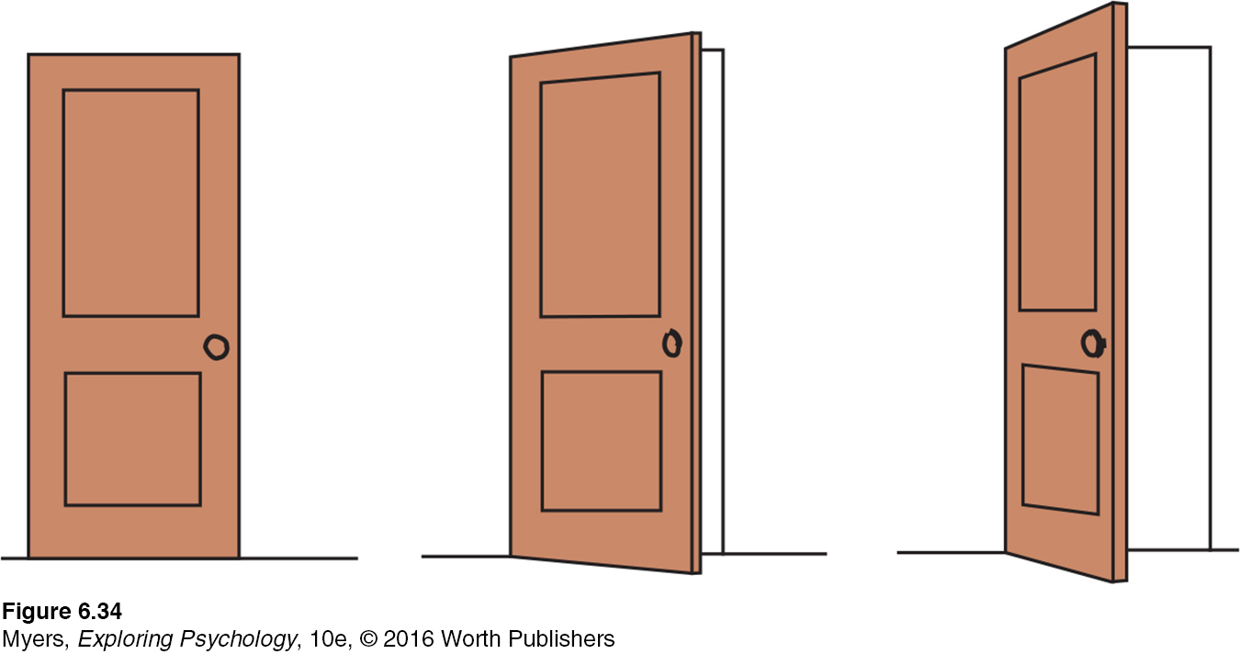
Perceptual Organization: Perceptual Constancy
Shape and Size constancies
Shape constancy: perceiving the form of familiar objects as constant even when our retinas receive changing images of them.
Size constancy: Perception of objects as having constant size even when distance from them varies
An opening door looks more and more like a trapezoid. Yet we still perceive it as a rectangle.
Notes:
Figure 17.23

Slide 45
Perceptual Organization: Perceptual Interpretation Experience and Visual Perception
6-15: WHAT DOES RESEARCH ON RESTORED VISION, SENSORY RESTRICTION, AND PERCEPTUAL ADAPTATION REVEAL ABOUT THE EFFECTS OF EXPERIENCE ON PERCEPTION?
Restored vision and sensory restriction
Effect of sensory restriction on infant cats, monkeys, and humans suggests there is a critical period for normal sensory and perceptual development
Without stimulation, normal connections do not develop
Perceptual adaptation
Ability to adjust to an artificially displaced or even inverted visual field
Notes:
Early nurture sculpts what nature has endowed

Slide 46
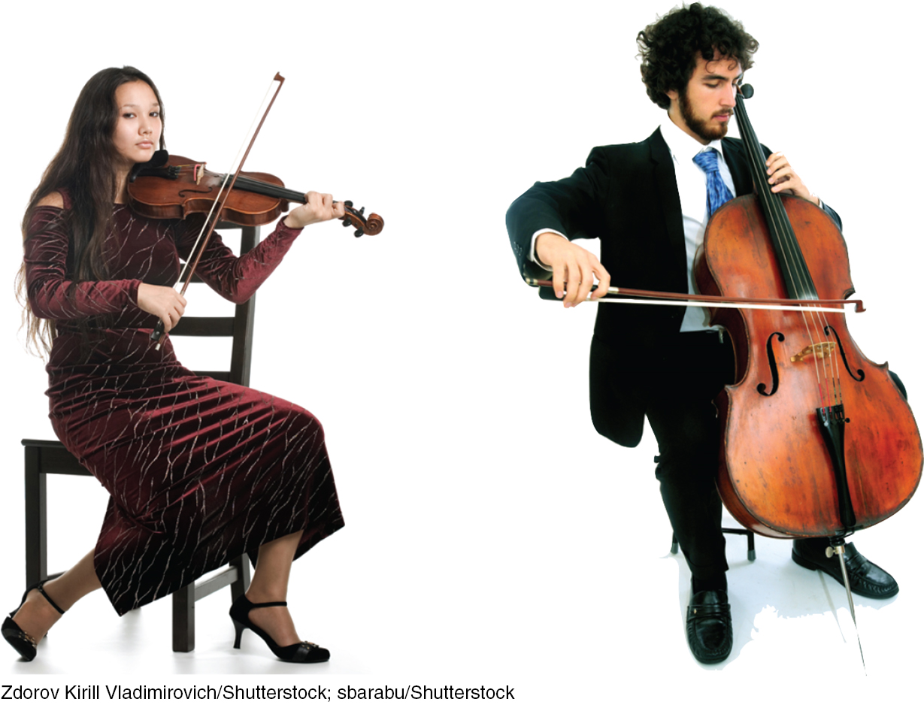
The Nonvisual Senses: Hearing
Sound waves: From the environment into the brain
Sound waves compress and expand air molecules
Ears detect these brief pressure changes
THE SOUNDS OF MUSIC: A violin's short, fast waves create a high pitch. The longer, slower waves of a cello or bass create a lower pitch. Differences in the waves’ height, or amplitude, also create differing degrees of loudness.
Notes:
Audition: The sense or act of hearing
Differences in the waves' height, or amplitude,
also create differing degrees of loudness.

Slide 47
The Nonvisual Senses: Hearing The Stimulus Input: Sound Waves
6-16: WHAT ARE THE CHARACTERISTICS OF AIR PRESSURE WAVES THAT WE HEAR AS SOUND?
Audition: The sense or act of hearing
Amplitude (height) determines intensity (loudness) in sound waves
Length (frequency) determines the pitch
Frequency: The number of complete wavelengths that pass a point in a given time (for example, per second)
Pitch: A tone’s experienced highness or lowness; depends on frequency
Sound is measured in decibels (dB)
Notes:
Low frequency = long wavelength = low pitch
Decibels
0 dB is the absolute threshold (not the absence of sound, just less than we can hear)
60 dB is normal conversation
85+ dB: prolonged exposure can cause hearing loss

Slide 48
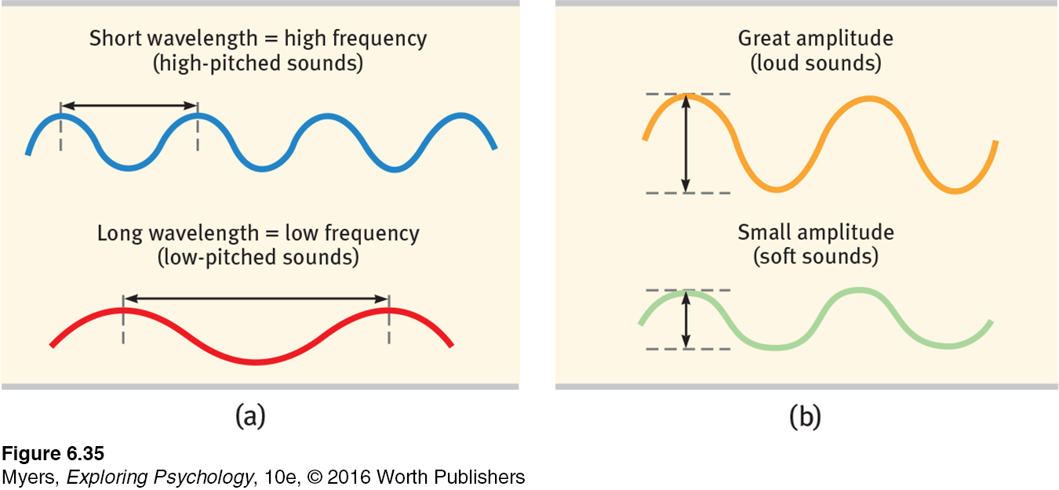
The Nonvisual Senses: Hearing The Stimulus Input: Sound Waves
Notes:
Figure 18.1
Low frequency = long wavelength = low pitch
Decibels
0 dB is the absolute threshold (not the absence of sound, just less than we can hear)
60 dB is normal conversation
85+ dB: prolonged exposure can cause hearing loss

Slide 49
The Nonvisual Senses: Hearing The Stimulus Input: Sound Waves
Sound waves are bands of compressed and expanded air.
Human ears detect these changes in air pressure and transform them into neural impulses, which the brain decodes as sound.
Sound waves vary in amplitude, which is perceived as differing loudness, and in frequency, which is experienced as differing pitch.

Slide 50
The Nonvisual Senses: Hearing The Ear
6-17: HOW DOES THE EAR TRANSFORM SOUND ENERGY INTO NEURAL MESSAGES?
Vibrating air (sound waves) enter the outer ear; pass through the auditory canal to the eardrum
Middle ear: Chamber between the eardrum and cochlea; contains three tiny bones that amplify the vibrations of the eardrum
Cochlea: A coiled, bony, fluid-filled tube in the inner ear; contains nerve receptors
Inner ear: Innermost part of the ear; contains cochlea, semicircular canals, and vestibular sacs

Slide 51
Hearing: Decoding Sound Waves
Sound waves strike the ear drum, causing it to vibrate
Tiny bones in the middle ear pick up the vibrations and transmit them to the cochlea, a coiled, fluid-filled tube in the inner ear
Ripples in the fluid of the cochlea bend the hair cells lining the surface, which trigger impulses in nerve cells
Axons from these nerve cells transmit a signal to the auditory cortex

Slide 52
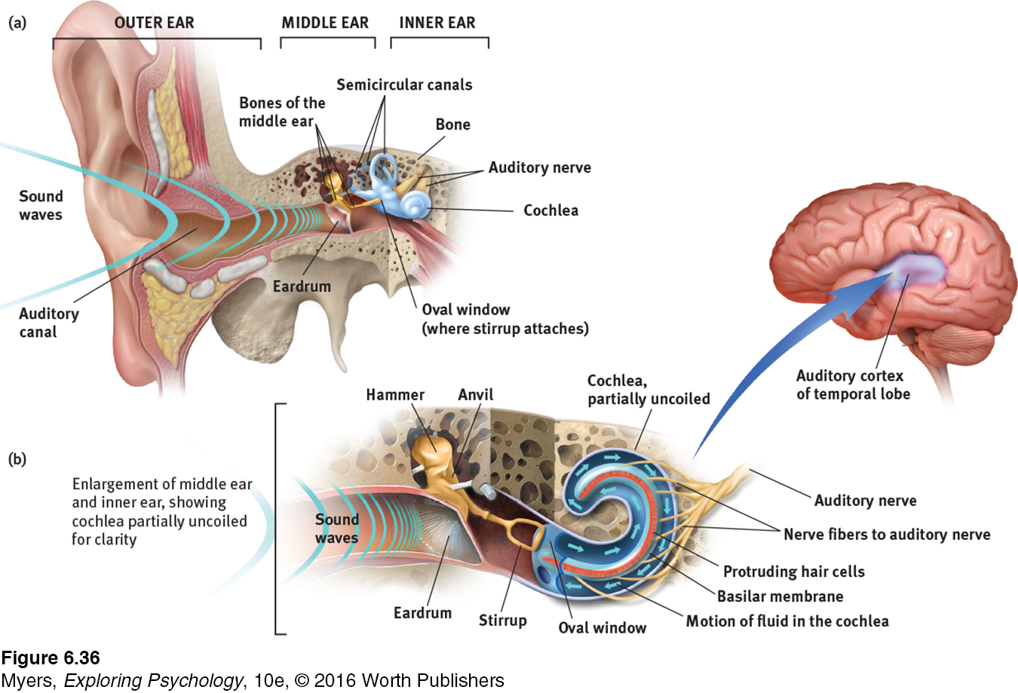
Transforming Sound Energy into Neural Messages
Notes:
Figure 18.2 Hear here: How we transform sound waves into nerve impulses that our brain interprets (a) The outer ear funnels sound waves to the eardrum. The bones of the middle ear (hammer, anvil, and stirrup) amplify and relay the eardrum’s vibrations through the oval window into the fluid-filled cochlea. (b) As shown in this detail of the middle and inner ear, the resulting pressure changes in the cochlear fluid cause the basilar membrane to ripple, bending the hair cells on its surface. Hair cell movements trigger impulses at the base of the nerve cells, whose fibers converge to form the auditory nerve. That nerve sends neural messages to the thalamus and on to the auditory cortex.

Slide 53
The Nonvisual Senses: The Ear
Sensorineural hearing loss (nerve deafness)
Damage to cell receptors or associated nerves
Conduction hearing loss
Damage to mechanical system that conducts sound waves to cochlea
Cochlear implant: a device for converting sounds into electrical signals and stimulating the auditory nerve through electrodes threaded into the cochlea.
Notes:
A neural response is triggered when the tiny bundles of cilia on top of even one of the 16,000 hair cells on the cochlea are moved even the width of an atom!
Cochlear implant a device for converting sounds into electrical signals and stimulating the auditory nerve through electrodes threaded into the cochlea.

Slide 54
The Nonvisual Senses: Hearing Perceiving Loudness, Pitch, and Location
6-18: HOW DO WE DETECT LOUDNESS, DISCRIMINATE PITCH, AND LOCATE SOUNDS?
Responding to Loud and Soft Sounds:
The brain interprets loudness from the number of activated receptors – soft tones activate fewer hair cells
Notes:
People who lose all hearing in one ear often have difficulty locating sounds.

Slide 55
The Nonvisual Senses: Hearing Perceiving Loudness, Pitch, and Location
Hearing Different Pitches:
Place theory in hearing: Theory that links the pitch heard with the place where the cochlea’s membrane is stimulated; best explains high pitches
Frequency theory (temporal theory) in hearing
Theory that the rate of nerve impulses traveling up the auditory nerve matches the frequency of a tone, thus enabling its pitch to be sensed; explains low pitches
Some combination of place and frequency theories seems to explain the pitches in the intermediate range

Slide 56
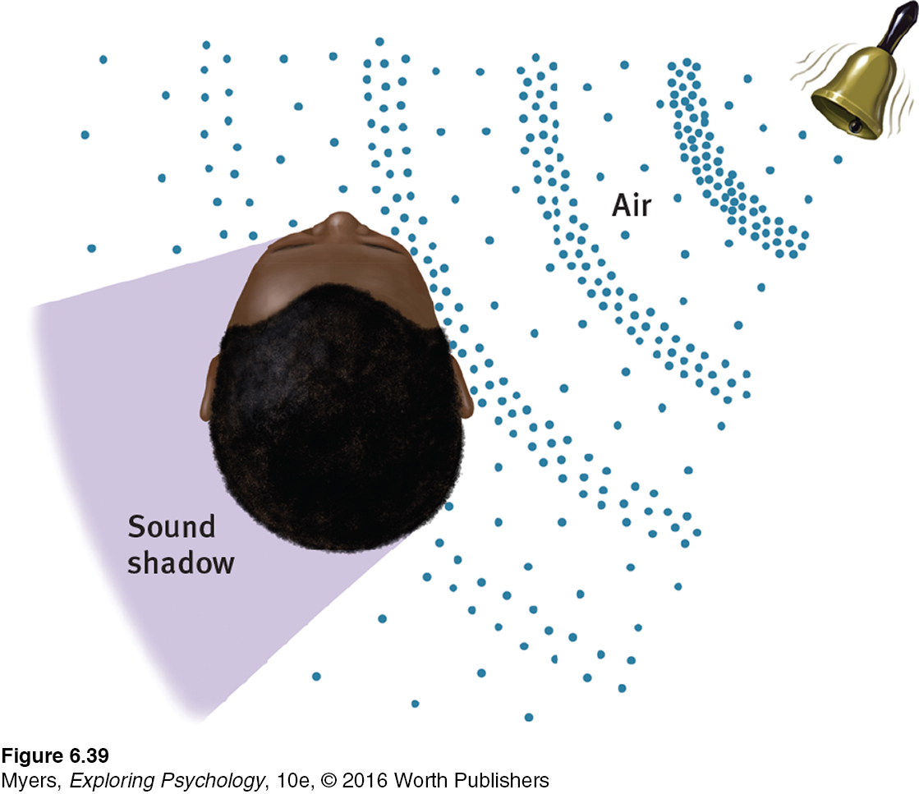
Locating Sounds
WHY TWO EARS ARE BETTER THAN ONE
Sound waves strike one ear sooner and more intensely than the other
From this information, our brain can compute the sound's location
Notes:
Figure 18.5
People who lose all hearing in one ear often have difficulty locating sounds.

Slide 57
The Other Senses: Touch
6-19: HOW DO WE SENSE TOUCH?
Sense of touch is actually a mix of four distinct skin senses
Pressure
Warmth
Cold
Pain
Other skin sensations are variations of the basic four.

Slide 58
The Other Senses: Pain
6-20: WHAT BIOLOGICAL, PSYCHOLOGICAL, AND SOCIAL-CULTURAL INFLUENCES AFFECT OUR EXPERIENCE OF PAIN? HOW DO PLACEBOS, DISTRACTION, AND HYPNOSIS HELP CONTROL PAIN?
Understanding Pain
Women are more sensitive to pain than men.
Pain sensitivity depends on genes, physiology, experience, attention, and surrounding culture.
Gate-control theory: The spinal cord contains a neurological “gate” that blocks pain signals or allows them to pass on to the brain.
The “gate” is opened by the activity of pain signals travelling up nerve fibers, and closed by activity in larger fibers or by information coming from the brain.

Slide 59
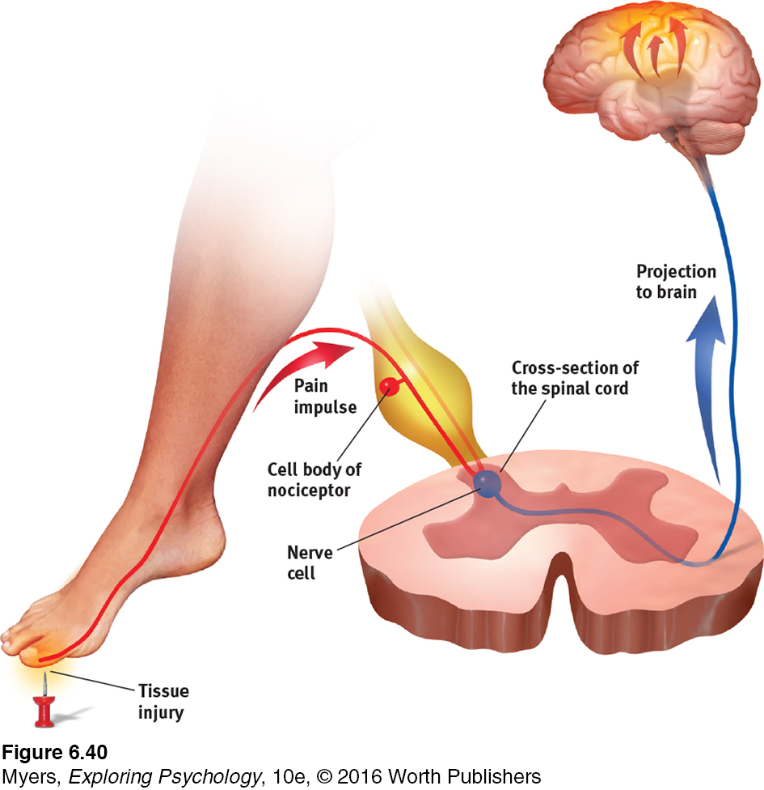
The Other Senses: Pain
Sensory receptors (nociceptors) respond to potentially damaging stimuli by sending an impulse to the spinal cord, which passes the message to the brain, which interprets the signal as pain.
Notes:
Figure 18.6

Slide 60
The Other Senses: Pain
Biopsychosocial Approach to Pain
Notes:
Figure 18.7

Slide 61
Controlling Pain
Placebo
Distraction
Hypnosis
Reduces CNS attention and responses to pain
Draws attention away from painful stimulation
fMRI scans reveal virtual reality play reduces brain’s pain-related activity
Social influence theory
Dissociation: Dual processing; sensory information does not reach areas where pain-related information is processed
Selective attention
Posthypnotic suggestion

Slide 62
The Other Senses: Taste
6-21: IN WHAT WAYS ARE OUR SENSES OF TASTE AND SMELL SIMILAR, AND HOW DO THEY DIFFER?
THE SURVIVAL FUNCTIONS OF BASIC TASTES
Like touch, taste
Involves several basic sensations
Can be influenced by learning, expectations, and perceptual bias
Has survival function
Taste | Indicates
Sweet | Energy source
Salty | Sodium essential to physiological processes
Sour | Potentially toxic acid
Bitter | Potential poisons
Umami | Proteins to grow and repair tissues
Notes:
Sensory interaction: one sense may influence another
Smell + texture + taste = flavor

Slide 63
The Other Senses: Taste
Inside each little bump on the top and sides of the tongue are 200+ taste buds
Each bud contains a pore with 50-100 taste receptors
Each kind of receptor reacts to different types of food molecules and sends messages to the brain

Slide 64
The Other Senses: Smell
Experience of smell (olfaction)
Like taste, smell is a chemical sense
Olfactory receptor cells in the olfactory bulb in the nose
A combination of several odor molecules stimulate different receptors to detect them
These patterns are interpreted by the olfactory cortex.

Slide 65
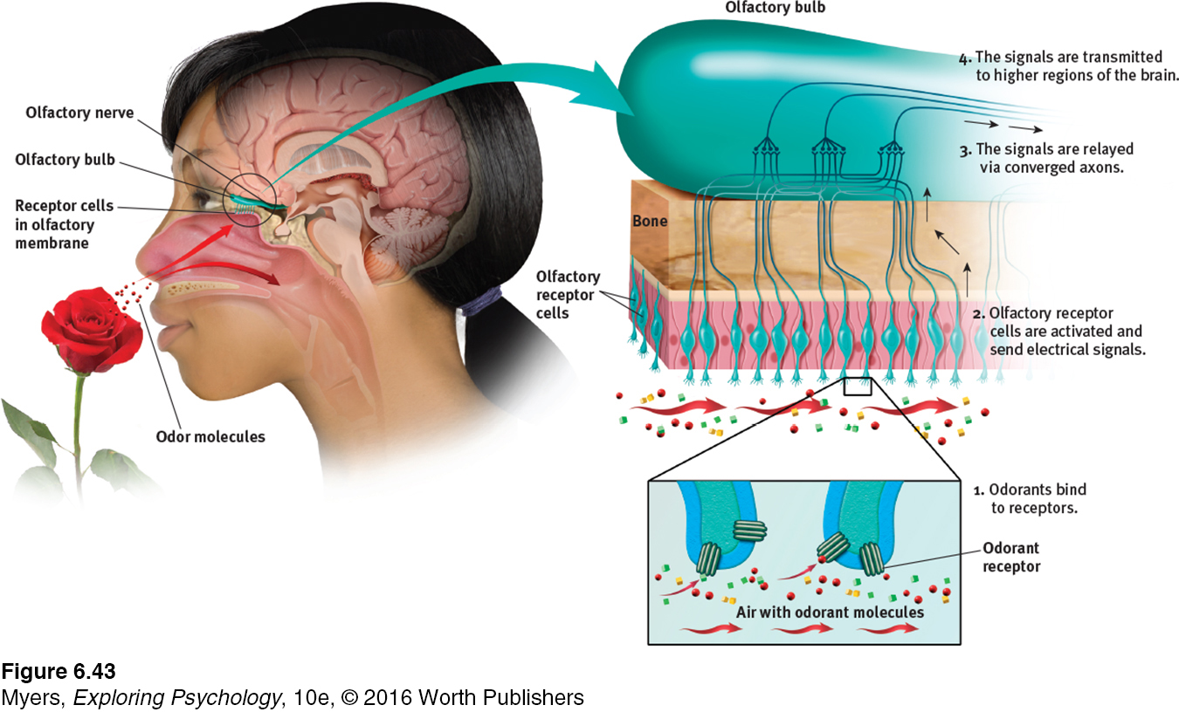
THE SENSE OF SMELL
Information from the taste buds travels to an area between the frontal and temporal lobes of the brain.
It registers in an area not far from where the brain receives information from our sense of smell, which interacts with taste.
Notes:
Figure 18.9 If you are to smell a flower, airborne molecules of its fragrance must reach receptors at the top of your nose. Sniffing swirls air up to the receptors, enhancing the aroma. The receptor cells send messages to the brain’s olfactory bulb, and then onward to the temporal lobe’s primary smell cortex and to the parts of the limbic system involved in memory and emotion.

Slide 66
The Other Senses: Smell
THE NOSE KNOWS Humans have some 20 million olfactory receptors. A bloodhound has 220 million (Herz, 2007).
Notes:
Different combinations of receptors identify different smells
Our brain's circuitry helps explain an odor's power to evoke feelings, memories, and behaviors.
A hotline runs between the brain area that receives information from the nose and brain centers associated with emotions and memories.

Slide 67
The Other Senses: Smell
Information from the taste buds travels to an area between the frontal and temporal lobes of the brain. It registers in an area not far from where the brain receives information from our sense of smell, which interacts with taste.
The brain's circuitry for smell also connects with areas involved in memory storage, which helps explain why a smell can trigger a memory.
Notes:
See Figure 18.10

Slide 68
The Other Senses: Body Position and Movement
6-22: HOW DO WE SENSE OUR BODY’S POSITION AND MOVEMENT?
Kinesthesia
System for sensing the position and movement of individual body parts
Interacts with vision
Vestibular sense
Sense of body movement and position, including the sense of balance

Slide 69
The Other Senses Sensory Interaction
6-23: HOW DOES SENSORY INTERACTION INFLUENCE OUR PERCEPTIONS, AND WHAT IS EMBODIED COGNITION?
Senses are not totally separate information channels
Sensory interaction: The principle that one sense may influence another, as when the smell of food influences taste
Examples of sensory interaction
Smell + texture + taste = flavor
Vision + hearing interact

Slide 70
The Nonvisual Senses: Sensory Interaction
Embodied cognition: Influence of bodily sensations, gestures, and other states on cognitive preferences and judgments
Examples
Physical warmth may promote social warmth
Social exclusion can literally feel cold
Political expressions may mimic body positions

Slide 71
Summarizing the Senses
Sensory System | Source | Receptors | Key Brain Areas
Vision | Light waves striking the eye | Rods and cones in the retina | Occipital lobes
Hearing | Sound waves striking the outer ear | Cochlear hair cells in the inner ear | Temporal lobes
Touch | Pressure, warmth, cold | Receptors, most in the skin, detect pressure, warmth, cold, and pain | Somatosensory cortex
Taste | Chemical molecules in the mouth | Basic tongue receptors for sweet, sour, salty, bitter, and umami | Frontal temporal lobe border

Slide 72
Summarizing the Senses (continued)
Sensory System | Source | Receptors | Key Brain Areas
Smell | Chemical molecules breathed in through the nose | Millions of receptors at top of nasal cavity | Olfactory bulb
Body position—kinesthesia | Any change in position of a body part, interacting with vision | Kinesthetic sensors in joints, tendons, and muscles | Cerebellum
Body movement—vestibular sense | Movement of fluids in the inner ear caused by head/body movement | Hair-like receptors in the ears’ semicircular canals and vestibular sacs | Cerebellum

Slide 73
Thinking Critically: ESP-Perception Without Sensation?
6-24: WHAT ARE THE CLAIMS OF ESP, AND WHAT HAVE MOST RESEARCH PSYCHOLOGISTS CONCLUDED AFTER PUTTING THESE CLAIMS TO THE TEST?
Most relevant ESP claims
Telepathy, clairvoyance, precognition
ESP studied by parapsychologists
What do YOU think?
Bem
Nine experiments that seemed to suggest participants could anticipate future events
Critics
Methods or analysis viewed as flawed
Most research psychologists and scientists are skeptical
Notes:
Extrasensory perception (ESP ) the controversial claim that perception can occur apart from sensory input, such as through telepathy, clairvoyance, and precognition.
Telepathy: mind-to-mind communication
Clairvoyance: perceiving remote events, such as a house on fire in another state
Precognition: perceiving future events, such as an unexpected death in the next month

